Slide 1
Responsive Web Design
Media Queries

Slide 2
Media Query
Media query is a CSS technique introduced in CSS3.
It uses the @media rule to include a block of CSS properties only if a certain condition is true.
Media queries are useful when you want to modify your site or app depending on a device’s width

Slide 3
Media Query
A media query is composed of an optional media type and any number of media feature expressions.
Media queries are case-insensitive.
A media query computes to true when the media type (if specified) matches the device on which a document is being displayed.
Expression needs to be true aswell.

Slide 4
Media Types
all: Suitable for all devices
screen: Intended primarily for color computer screens.
Speech: Intended for speech synthesizers.
tv:Intended for television-type devices (low resolution, color, limited-scrollability screens, sound available).
Projection:Intended for projected presentations, for example projectors.

Slide 5
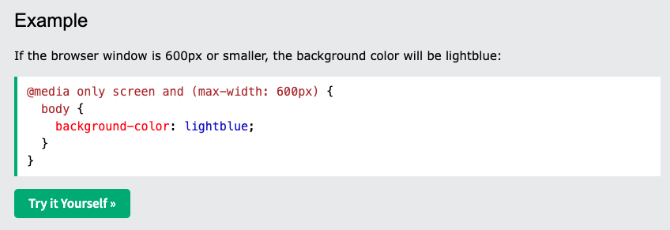
Example
Notes:
@media only screen and (max-width: 900px)
{
body {
background-color: red;
}
}

Slide 6
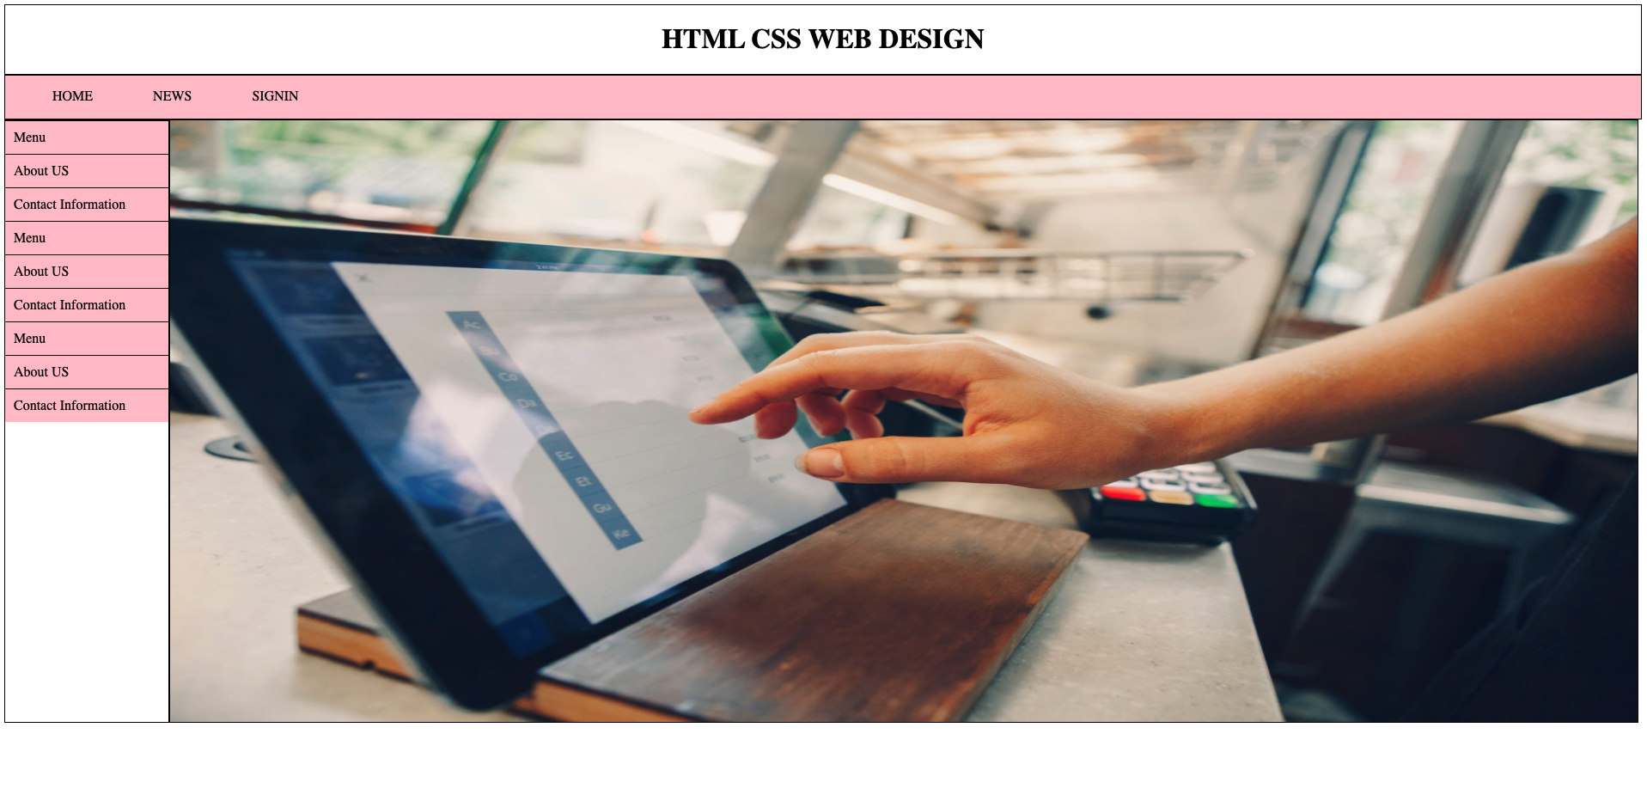
Responsive
Earlier in this lab we made a web page with DIVS, and it was responsive, but it did not look good on a small screen.

Slide 7
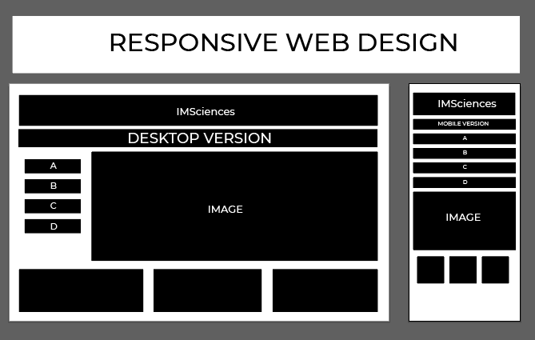
TASK
Make the following webpage – Both Desktop and Mobile Version

